Slide 1
A Data science Project on
“HOUSING PRICE PREDICTION”
Submitted by: Santosh Arvind Dharam

Slide 2
Problem Statement
A US-based housing company named Surprise Housing has decided to enter the Australian market. The company uses data analytics to purchase houses at a price below their actual values and flip them at a higher price. For the same purpose, the company has collected a data set from the sale of houses in Australia. The data is provided in the CSV file below. The company is looking at prospective properties to buy houses to enter the market. You are required to build a model using Machine Learning in order to predict the actual value of the prospective properties and decide whether to invest in them or not. For this company wants to know:
• Which variables are important to predict the price of variable?
• How do these variables describe the price of the house?

Slide 3
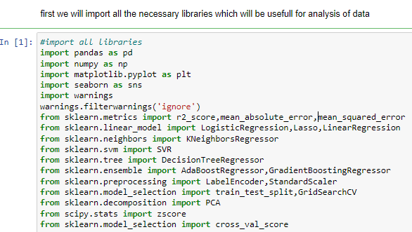
EDA steps step-1(import necessary libraries)

Slide 4
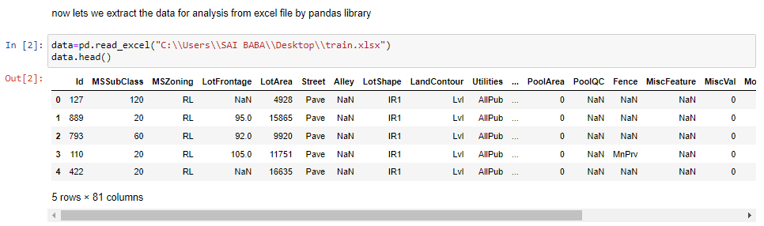
Step-2(extract the dataset in jupyter notebook) Data is extracted for further analysis in jupyter notebook

Slide 5
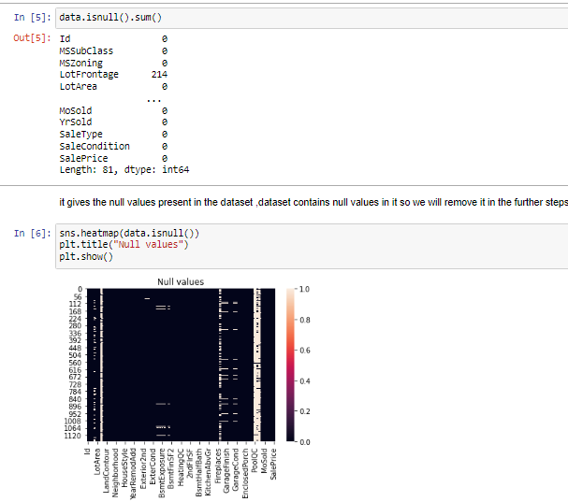
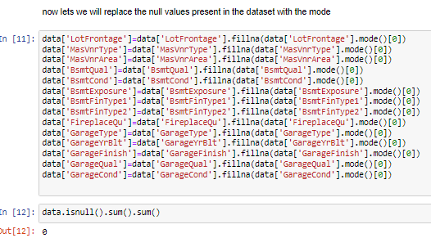
Step-3(checking and removing null values)

Slide 6
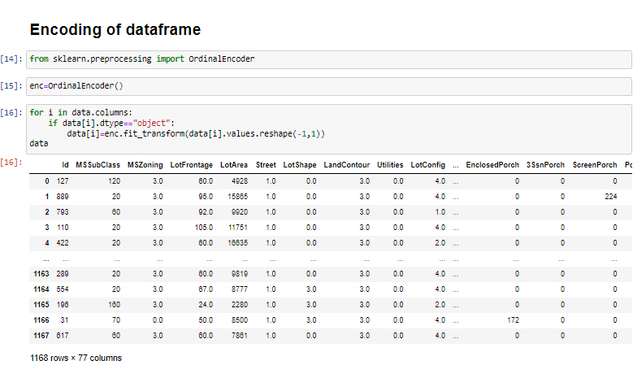
Step-4(Data Encoding) Data contains 77 columns and 1168 rows

Slide 7
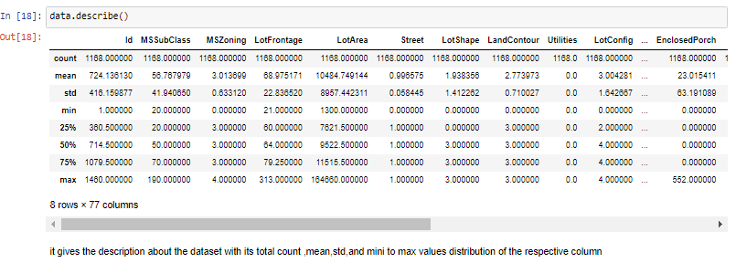
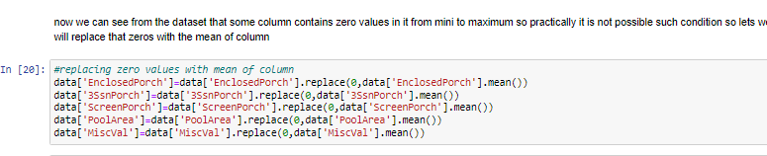
Step-5(Data Description and removing zero values present in min rows)

Slide 8
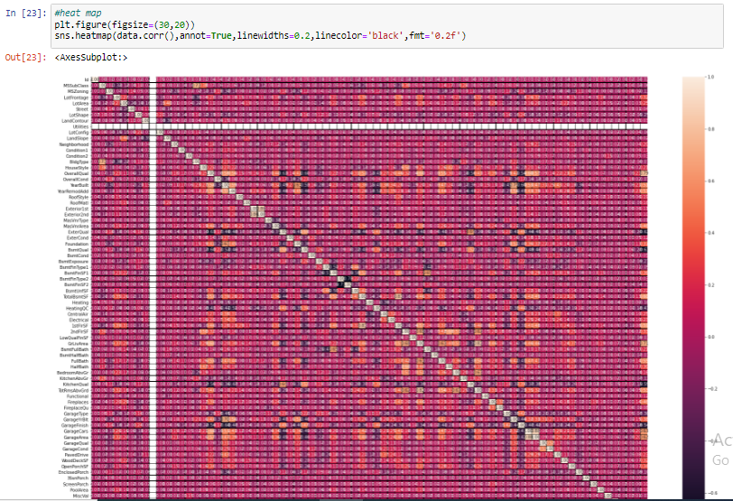
Heat Map(corelation between target column and sucessive column)

Slide 9
Observations from plot
Data is correlated with other column data and also with its own it also gives the positive negative correlation of data with respective one another. it shows that some column has maximum correlation with the sale price.also the column ‘Utilities’ has no data present in it so lets we will drop that column. now lets we will find the outliers present in the dataset with the box plot

Slide 10
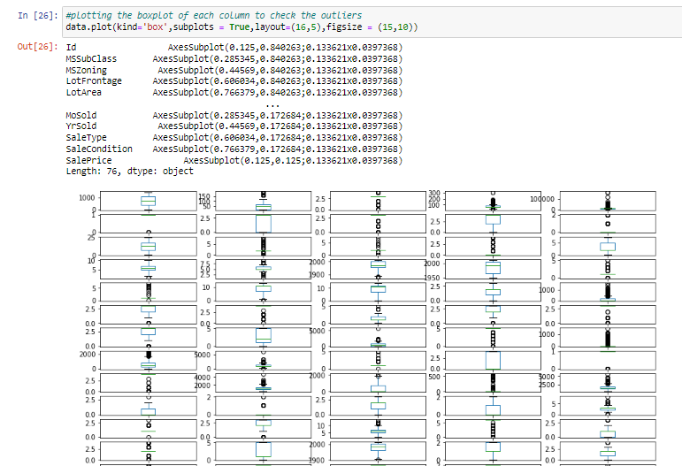
Checking of Outliers

Slide 11
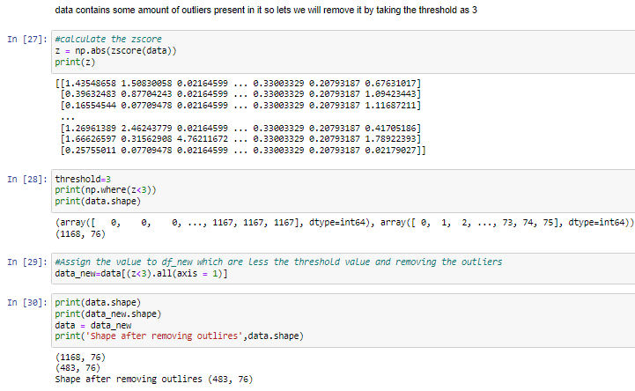
Removing outliers So after removing the outliers we have 483 rows and 76 column remaining

Slide 12
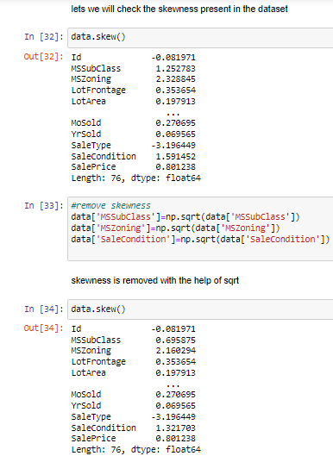
Finding the skewness in dataset

Slide 13
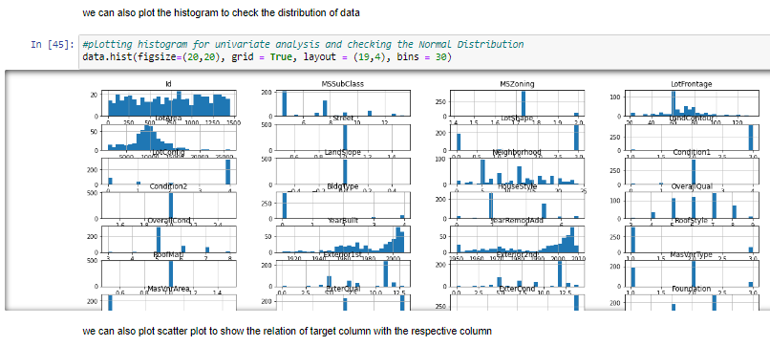
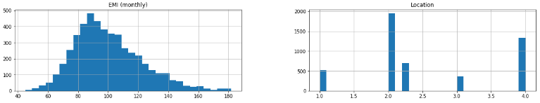
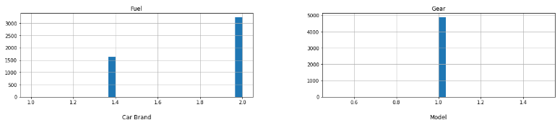
Graphical Representation of Data

Slide 14
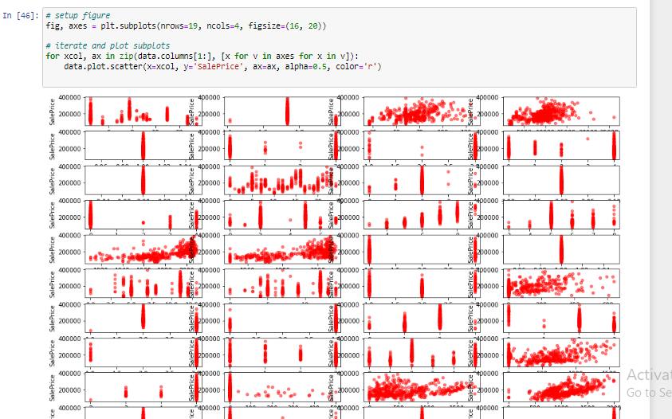
Scatter Plot It shows the linear relationship between target variable and respective columns

Slide 15
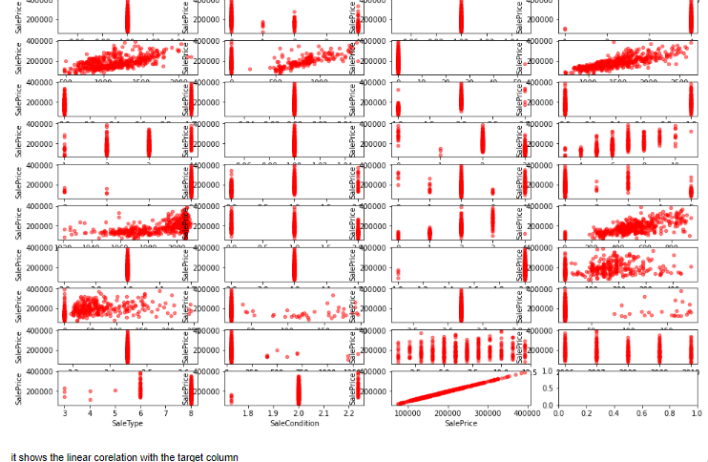

Slide 16
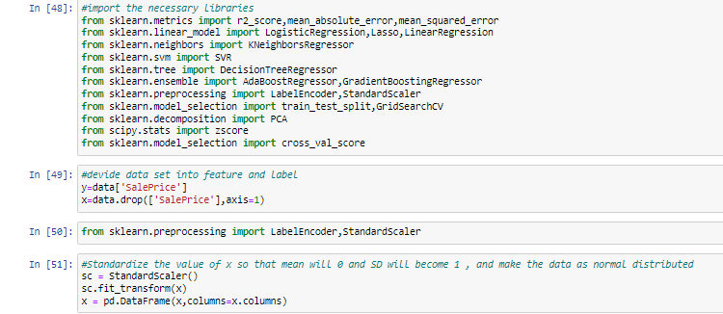
Divide dataset into x and y variable

Slide 17
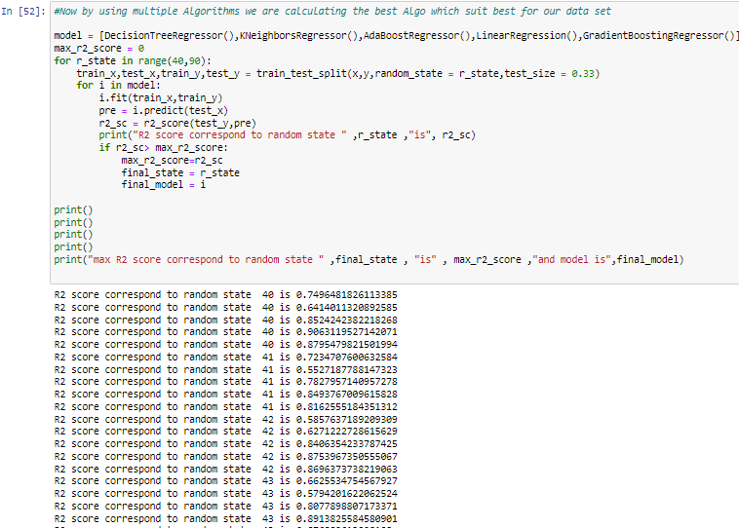

using multiple Algorithms we are calculating the best Algo which suit best for our data set

Slide 18
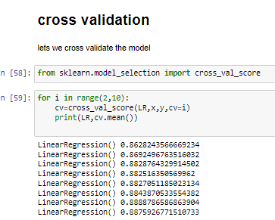
Cross Validation

Slide 19
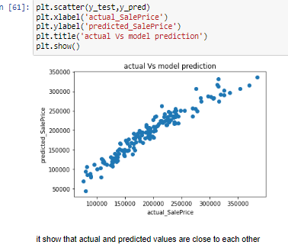
Visualization

Slide 20
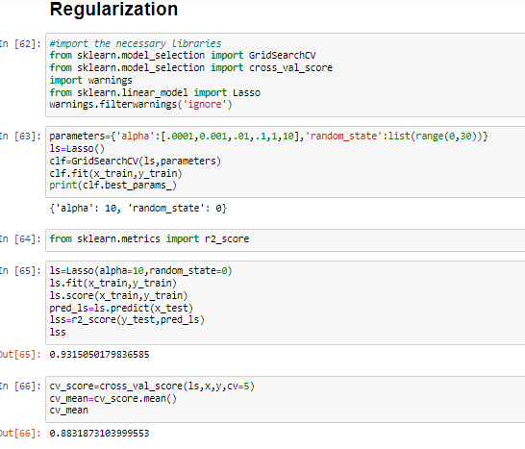
Regularization We have done a regularization from that we got cv score as 88.31% and R2 score as 93.15%

Slide 21
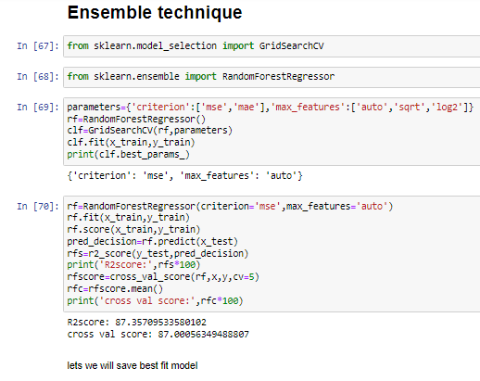
Ensemble technique from this we got a R2score as 87.35% and cross validation score as 87%

Slide 22
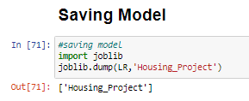

Slide 23
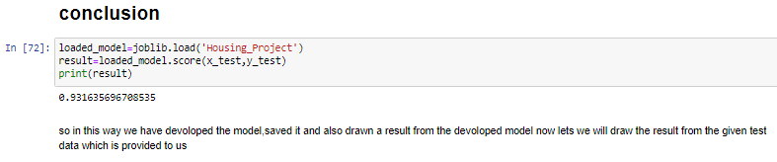
Conclusion

Slide 24
We observed that data was filled with some outliers it is removed, also there some encoding is done now data is uniformly distributed in column. it is also observed from sub plot, we have saved model and also predicted the result with help of saved model .model is ready for the future data prediction. now lets we will draw the result from the given test data which is provided to us.

Slide 25
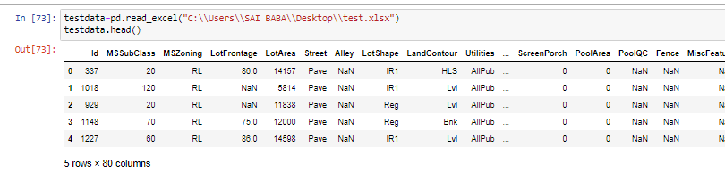
extract the test dataset in jupyter notebook

Slide 26
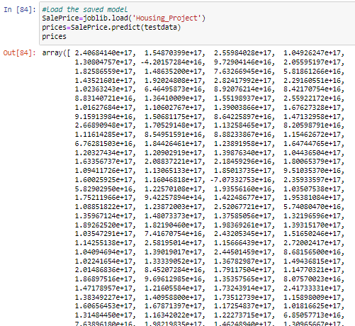
Load saves model and predict the result for test data

Slide 27
So in this way we have developed LinearRegression() model, we saved it and also predicted the results

